Slide 1
Comparative Analysis of depreciation method
Straight-Line vs. Diminishing Balance

Slide 2
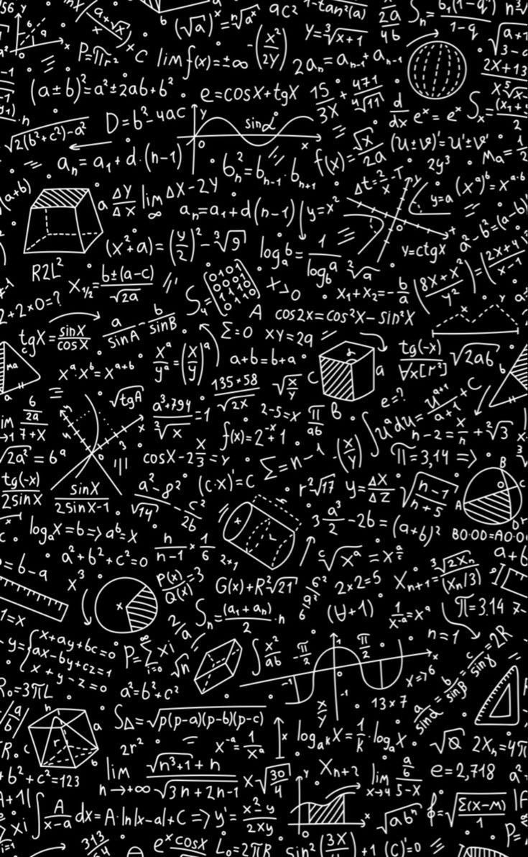
----------Introduction-----------
1. Definition of Depreciation: Depreciation is the systematic allocation of the cost of a tangible asset over its useful life. It reflects the reduction in value of an asset as it is used over time.
Importance of Depreciation in Accounting:- Depreciation helps in matching the cost of the asset with the revenue it generates. It provides a method to allocate the cost of the asset over its useful life, impacting both the income statement and the balance sheet. Depreciation also helps in tax deduction, as it is considered an expense.
2. Project Scope
The scope of this analysis is to evaluate and contrast two primary methods of depreciation:
Straight-Line (SL) Method: A constant annual expense.
Diminishing Balance (DB) Method: An accelerated annual expense.
This analysis is based on the provided asset data: Asset Price ($500,000), Scrap Value ($50,000), and a 10-year Estimated Life Span.
3. Objectives
The core objectives of this project are:
To generate a detailed year-by-year depreciation schedule for both methods.
To analyze the financial implications of each method (annual expense, book value, and total depreciation).
To provide a Visual Graphs Representation to illustrate the practical difference between a constant vs. an accelerated depreciation approach.
To determine the suitability of each method under various business circumstances.

Slide 3
---------- input----------
1. Project Input Data
The foundation of the analysis is based on the following asset parameters:
Component | Value | Description
Asset Cost (Initial) | 4,50,000.00 | Purchase Price of the Asset
Additional Costs | 50,000.00 | Costs like Transportation & Installation
Asset Price (Total Cost) | 5,00,000.00 | Total Capitalized Cost (450k + 50k)
Scrap/Salvage Value (S) | 50,000.00 | Estimated value at the end of its useful life
Estimated Life Span (n) | 10 Years | The period over which the asset will be depreciated
DB Rate | 19.72584382% | The specified rate for Diminishing Balance calculations

Slide 4
-----------Methodologies-----------
I employed two distinct methods, each governed by its own formula, to generate the 10-year depreciation schedules:
1. Straight-Line (SL) Method
This method assumes an equal amount of the asset's cost is consumed each year.
{Annual Depreciation} = {Total Cost} - {Scrap Value}\{Estimated Life Span}
{Annual Depreciation} = 5,00,000 - 50,000/10 = 45,000.00
2. Diminishing Balance (DB) Method
This is an accelerated method where a fixed depreciation rate is applied to the asset's Beginning
Book Value each year, resulting in larger expenses early in the asset's life.
{Annual Depreciation} = {Beginning Book Value} *{Rate of Depreciation}

Slide 5
------Key Findings-----
1) Calculate the annual depreciation amount using the straight line method for the given asset.
The formula for annual straight-line depreciation is:
{Annual Depreciation} = {Total Cost} - {Scrap Value}\{Estimated Life Span}
Calculation
Annual Depreciation = $500,000.00 - $50,000.00\10
Annual Depreciation = $450,000.00\10
Annual Depreciation = $45,000.00
2) Calculate the total depreciation for the asset's entire life span using the straight-line method.
The Formula
Under the Straight-Line method, the Total Depreciation (also known as the Depreciable Amount) is simply the difference between the total cost and the scrap value.
Total Depreciation = Asset Price - Scrap Value
Calculation
Total Depreciation = 500,000.00 - 50,000.00
Total Depreciation = 450,000.00

Slide 6
3) What is the depreciated book value of the asset after its life span using the straight-line method?
Calculation
The depreciated book value is calculated by subtracting the total accumulated depreciation from the
initial total cost:
{Book Value after 10 years = Asset Price - Total Accumulated Depreciation
Book Value after 10 years = $500,000.00 - $450,000.00
Book Value after 10 years = $50,000.00
4) Calculate the rate of depreciation per year as per the diminishing balance method.
The standard formula to find the rate (r) required to reduce an asset's cost (C) to its scrap value (S) over its useful life (n) is:
r = 1 – (S/C)^1/n
Identify the Values:
Total Asset Price (C): $500,000.00
Scrap Value ($S$): $50,000.00
Estimated Life Span (n): 10 Years
The Calculation Steps
Using the values above:-
Divide Scrap Value by Total Cost: $50,000 \$500,000 = 0.1
Calculate the nth Root: Find the $10^th root of $0.1 (or $0.1 raised to the power of $0.1).
  $(0.1)^{0.1} ~ 0.794328$
Subtract from 1: 1 - 0.794328 = 0.205672
While the standard mathematical formula yields approximately 20.57\%, the specific rate provided and used in your calculations for this project is:

Slide 7
5) What is the depreciation amount for the asset in the second year according to the diminishing balance method?
Calculation :-
Step 1: Calculate Year 1 Depreciation
{Year 1 Depreciation} = $500,000.00 * 0.1972584382 = $98,629.22
Step 2: Calculate Beginning Book Value for Year 2
Book Value (Start of Year 2) = $500,000.00 - $98,629.22 = $401,370.78
Step 3: Calculate Year 2 Depreciation
Year 2 Depreciation} = 401,370.78 times 0.1972584382$$
Year 2 Depreciation = 79,173.77
6) What is the book value of the asset in the fourth year using the diminishing balance method?
Identify the Initial Values
Total Asset Price: $500,000.00
Rate of Depreciation: $19.72584382(or $0.1972584382$)
2. Year-by-Year Calculation
End of Year 1:
  Depreciation: $500,000 *0.1972584382 = \$98,629.22$
  Book Value: $500,000 - $98,629.22 = $401,370.78
End of Year 2:
  Depreciation: $401,370.78 * 0.1972584382 = $79,173.77$
  Book Value: $401,370.78 - $79,173.77 = $322,197.01$
End of Year 3:
  Depreciation: $322,197.01 * 0.1972584382 = $63,556.08
  Book Value: $322,197.01 - $63,556.08 = $258,640.93
End of Year 4:
  Depreciation: $258,640.9 * 0.1972584382 = $51,019.11
  Book Value: $258,640.93 - $51,019.11 = $207,621.82

Slide 8
7) Calculate the total depreciation for the asset's entire life span using the diminishing balance method.
Calculation
There are two ways to arrive at this figure:
Method A: Sum of Annual Depreciation
You add the depreciation amount from each year of your schedule:
Year 1: $98,629.22
Year 2: $79,173.77
(Years 3-9)
Year 10: $13,651.57
Total: $444,444.44
Method B: Total Cost Minus Ending Book Value
This is the quickest way to verify the total:
Total Depreciation = Initial Asset Price - Ending Book Value (Year 10)
Total Depreciation = $500,000.00 - $55,555.56
Total Depreciation = $444,444.44
8) What is the book value of the asset after its life span using the diminishing balance method?
Book Value (Year 10) = Beginning Book Value (Year 10) - Annual Depreciation
(Year 10)
Book Value (Year 10) = $69,207.26 - $13,651.70 = $55,555.56

Slide 9
9) Compare the total depreciation amounts obtained from the straight-line method and the diminishing balance method. Which method results in higher total depreciation?
Comparison of Total Depreciation
Method | Total Depreciation Amount | Ending Book Value (Year 10)
Straight-Line (SL) | $450,000.00 | $50,000.00
Diminishing Balance (DB) | $444,444.44 | $55,555.56

Slide 10
10) Prepare a Presentation for above Analysis you made so far along with Visual Graphs representation
Annual Depreciation Expense Analysis :-
Observation: The Straight-Line (SL) method shows a perfectly horizontal line at $45,000, representing a uniform cost distribution. In contrast, the Diminishing Balance (DB) method shows a steep downward curve, starting at nearly $98,630 and ending at approximately $13,65.
Insight: The DB method "front-loads" the expense, which is highly beneficial for businesses looking to maximize tax deductions in the first three years of an asset's life.

Slide 11
2. Ending Book Value Analysis :-
Observation: The SL Book Value decreases at a constant rate, forming a straight diagonal line that hits the target $50,000 scrap value exactly. The DB Book Value drops much more aggressively in the early years but flattens out towards the end.
Insight: The DB curve more accurately reflects the "Fair Market Value" of the asset. Most equipment loses a significant chunk of its resale value the moment it is put into use, which the DB curve represents better than the SL diagonal.

Slide 12
------------Conclusions-------------
This final section summarizes the results of the 10-year depreciation study for the $500,000 asset.
1. Key Findings Summary
Method Efficiency: The Straight-Line (SL) method proved to be more precise for reaching the exact $50,000 scrap value. The Diminishing Balance (DB) method, while faster at the start, left a higher residual book value of $55,555.56 at the end of the term.
Total Write-off: The total depreciation recorded was higher under the Straight-Line method $450,000 than the specific DB rate used -$444,444.44
2. Strategic Conclusion
The choice of depreciation method is not just an accounting requirement but a strategic business decision:
Choose Straight-Line if the business goal is to present steady, reliable profits and simple financial statements. It is best for assets that don't become obsolete quickly.
Choose Diminishing Balance if the business goal is cash flow management. By taking larger deductions early on, the company pays less tax during the years it is likely also paying off the asset's purchase loan.
3. Final Statement
After analyzing both methods, it is concluded that for a high-value asset worth $500,000, the Diminishing Balance method provides a more realistic representation of the asset's market value decline, despite the Straight-Line method offering a more complete depreciation of the cost down to the scrap value.

